Slide 1
Carrier concerns and issues
Satellite based VoIP
TIA-SCD and SIA Joint Meeting
Washington DC
15 April 2003
Anthony M Rutkowski
Vice President, NetDiscovery Service
VeriSign
mailto:tony@verisign.com
President, Global LI Industry Forum
Notes:
Welcome to all the locations
My name is Rebecca Stillings, Director of NextGen Services in the Telecommunication Services division. For those of you who don’t know me in addition to CALEA I am the Director of Number Portability Services and was the project manager of ILLUMINET’s deployment of that service.
I am also the project director for the opportunity you are here to hear about. This is a very exciting opportunity, leveraging assets across VeriSign. This service leverages our core competencies as a service bureau, network provider and trusted supplier or services.
I’m quite excited to be sharing this with you today!

Slide 2
Summary
Carriers concerned about all expenditures peripheral to their core business
Regulatory uncertainties exist for satellite access
Carriers with a global footprint and LEAs have additional challenges due to multiple Lawful Interception requirements and standards with new laws coming into force
Multiple VoIP Lawful Interception solutions for carriers are emerging
The VoIP meta-architecture will significantly affect carriers
More attention is needed to reducing carrier LI investigative support costs

Slide 3
Adverse Impacts on Carriers
Intercept solutions costly
  Hardware and software expenditures
  Mediation devices
Large on-going operational expenses
  Dedicated Security Office Personnel
  Compliance to Legal/Regulatory Procedures for System Security & Integrity
  Network Operations Staff for supporting network connectivity for each LEA
  Assistance to LEAs in initial connectivity or on-going surveillance support
  Legal liabilities for non-compliant Security Policies and unauthorized disclosure of legal order information
LI preliminary investigative support requirements can be equally significant
  Directories and identifier discovery
  Communications detail records searches
LEAs often reluctant to use lower cost secure VPN technology

Slide 4
Regulatory uncertainties for satellite access
Statutory treatment
The term “telecommunications carrier”--
  (A) means a person or entity engaged in the transmission or switching of wire or electronic communications as a common carrier for hire; and
  (B) includes--
    (i) a person or entity engaged in providing commercial mobile service (as defined in section 332(d) of the Communications Act of 1934 (47 U.S.C. 332(d))); or
    (ii) a person or entity engaged in providing wire or electronic communication switching or transmission service to the extent that the Commission finds that such service is a replacement for a substantial portion of the local telephone exchange service and that it is in the public interest to deem such a person or entity to be a telecommunications carrier for purposes of this title; but
  (C) does not include--
    (i) persons or entities insofar as they are engaged in providing information services; and
    (ii) any class or category of telecommunications carriers that the Commission exempts by rule after consultation with the Attorney General.
  Title I--Interception Of Digital And Other Communications, Sec. 102, para 8). Definitions. Communications Assistance for Law Enforcement Act of 1994, Pub. L. No. 103-414, 108 Stat. 4279
47 USC Sec. 332 Mobile services
  (d) Definitions
  For purposes of this section -
    (1) the term ''commercial mobile service'' means any mobile service (as defined in section 153 of this title) that is provided for profit and makes interconnected service available (A) to the public or (B) to such classes of eligible users as to be effectively available to a substantial portion of the public, as specified by regulation by the Commission;
    (2) the term ''interconnected service'' means service that is interconnected with the public switched network (as such terms are defined by regulation by the Commission) or service for which a request for interconnection is pending pursuant to subsection (c)(1)(B) of this section; and
    (3) the term ''private mobile service'' means any mobile service (as defined in section 153 of this title) that is not a commercial mobile service or the functional equivalent of a commercial mobile service, as specified by regulation by the Commission.

Slide 5
Regulatory uncertainties for satellite access
FCC treatment
FCC CC Docket 97-213
  Notice Of Proposed Rulemaking, FCC 97-356 (10 Oct 1997) at para 17.
    We conclude that Congress intended the obligations of CALEA to have broad applicability, subject only to the limitations in scope explicitly contained in the statute. We propose not to adopt a specific list of carriers subject to these obligations because we expect that the types of entities subject to CALEA may change over time. We do propose, however, including in the rules that may be adopted in this proceeding the following list as examples of the types of entities that are subject to CALEA's requirements to the extent that they offer telecommunications services for hire to the public:
      satellite-based service providers
  Second Report And Order, FCC 99-22 (31 Aug 1999) at para 27.
    Where facilities are used solely to provide an information service, whether offered by an exclusively-IS provider or by a common carrier that has established a dedicated IS system apart from its telecommunications system, we find that such facilities are not subject to CALEA. Where facilities are used to provide both telecommunications and information services, however, such joint-use facilities are subject to CALEA in order to ensure the ability to surveil the telecommunications services. For example, digital subscriber line (DSL) services are generally offered as tariffed telecommunications services, and therefore subject to CALEA, even though the DSL offering often would be used in the provision of information services. On the other hand, where an entity used its own wireless or satellite facilities to distribute an information service only, the mere use of transmission facilities would not make the offering subject to CALEA as a telecommunications service.
FCC Dockets 02-33 (wireline) and 02-52 (cable) remain open
  Deal with framework and CALEA obligations for Broadband Internet Access providers for wireline and cable
  “Parity” reference to satellite providers and Trends Data including Small Business references

Slide 6
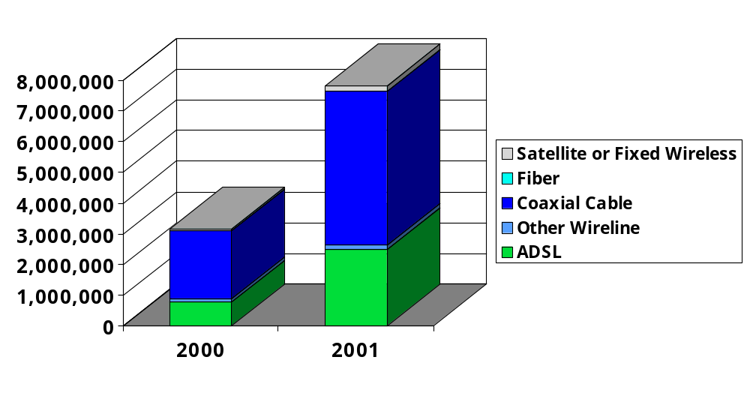
Satellite Carrier Trends; Comparison
In 2001, there were 31 satellite service carriers, 25 are classified as small businesses. Only 15 were providing telecommunication service.
Satellite and Terrestrial Fixed Wireless Carriers provided
  194,707 High-Speed Lines over 200 kbps in at least one direction, of which
    182,165 were Residential and Small Business
  73,476 Advanced Services Lines Over 200 kbs in both direction, of which
    60,988 were Residential and Small Business

Slide 7
Current Satellite Carriers
FCC 2001 data
Reported jurisdictions in which carrier is providing telecommunication service
Loral Orion Services (Loral) 0
Loral Orion (Loral) 0
Maritime Telecommunications
Network (Verestar) 0
Medley International Teleport 0
MSV (Mobile Satellite Ventures ) 54
Orbcom Global 0
PanAmSat Corporation 0
SES Americom, Inc. 16
Satellite & Technology Corporation 1
Seven Seas Communications 0
Sola Communications 5
Space Com Systems 53
Standard Communications 0
Stratos Communications 53
Nova-Net or Stratos (Stratos) 0
Telenor Satellite Services 0
Verestar 0
Auto Phone Communications (White
Cloud Communications) 0
ATC Teleports 0
Andesat S.A.E.M.A. Corporation 1
Comsat Corporation/Comsat Mobile Communications (Lockeed Martin) 0
COMSAT International 0
Catalina Transmission Corp. 1
Charles Beard 1
Corporate Satellite Communications
of Florida 1
Preferred Communications (Crystal
Digital Communications, Inc. ) 53
CyberStar (Loral) 0
GE Capital Europe 6
General Dynamics-Satellite
Communications Services 0
IMPSAT - USA (Impsat Fiber
Networks ) 10
Infosat 20
Interlink Communications
(Telscape International, Inc ) 7
International Satellite Services 59
Iridium Satellite 0

Slide 8
New requirements for carriers with a global footprint and LEAs
New laws coming into force will significantly affect some carriers (and LEAs)
  Convention on Cybercrime
  Mutual Assistance Multilateral and Bilateral Agreements, especially the 2000 European MLAT 2nd Protocol
  Homeland Security Information Sharing Act
  Transnational interceptions and handovers likely to be commonplace
Multiple independent Lawful Interception provisions and standards substantially drive up costs of compliance and implementation
  Raises many issues, including discovery phase obligations
VoIP will be a major focus of transnational LI

Slide 9
Multiple VoIP Lawful Interception solutions for carriers are emerging
Cisco has just announced a new, highly effective, standards-based, service independent LI architecture for worldwide use
  www.ietf.org/internet-drafts/draft-baker-slem-architecture-00.txt
  www.ietf.org/internet-drafts/draft-baker-slem-mib-00.txt
  Initial implementation will support VoIP network elements
  Other vendors are following Cisco lead
  All mediation and collection system vendors are implementing
  VeriSign NetDiscovery Service™ has already implemented and tested as a cost-effective service bureau architecture
What is not intercepted from built-in VoIP network elements can be extracted from traffic streams using special access devices and probes offered by existing vendors (e.g., TopLayer-Verint/SS8, ECtel, Aqsacom)
More difficult issues involve the interception of third party signalling information and availability of identifier information

Slide 10
VoIP LI Standards (by scope)
Generic Handover
  Cisco TapMIB et seq.
  ETSI ES 201 671v2.1.1 (2001-09)*[also known as GLIC or ULIC]; TS 101 671 V2.4.1 (2002-10)**
  Germany REGTP TR FÜV V3.0 (2001-11)* [modified ETSI specification]
  TIA J-STD-025A*; PN-4465-RV1.12 (14 Jan 2003)**
  UK HO NHIS V1.0 (2002-05)* [replaces GHIS, modified ETSI specification]
IP Handover
  ETSI DES/SEC-003020 V0.3.0 (2002-10)**
  Netherlands EZ TIIT V1.0.0 (2002-09)*
Wireless IP Handover
  3G/UMTS
    3GPP TS 33.108v5.1.0 (2002-09)*
Cable IP Handover
  Cable Labs PKT-SP-ESP-I01-991229*
  SCTE 24-13 2001**
Cable IP Handover for Voice & Multimedia
  ETSI ES_101 909-20.1 V.0.0.11 (2002-11)**
Softswitch Based Networks
  ISC [unknown] (27 Nov 2002)**
VoIP
  DTS/TIPHON-03020v1.0.1(2002-11)**
Wireline VoP (includes VoIP, VoMPLS, and VoATM)
  ANSI T1.XXX-XXXX (T1S1 Doc. 3s100030)**
*Adopted and **most current draft versions listed

Slide 11
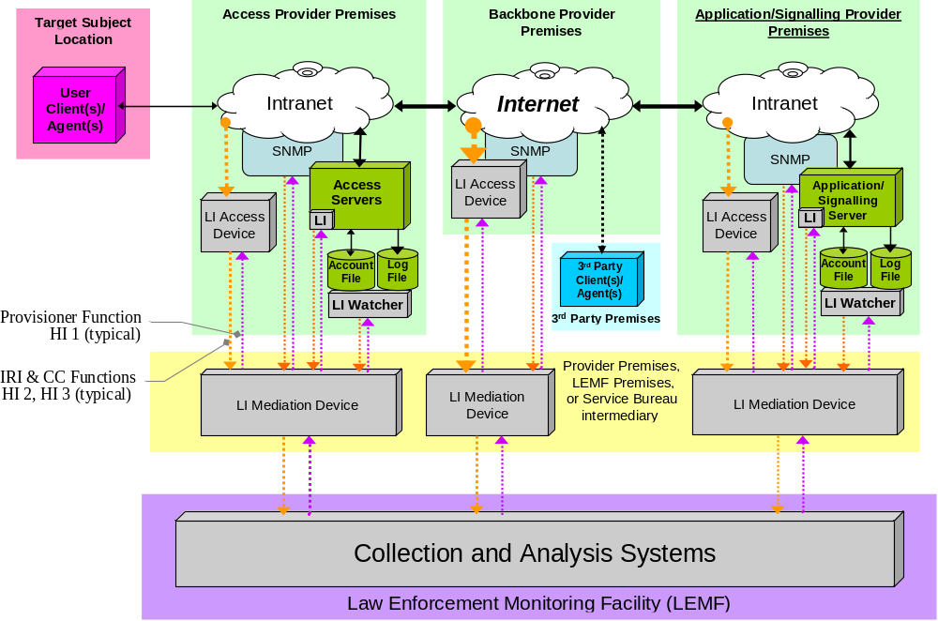
The VoIP meta-architecture significantly affects carriers
From An Internet Ecosystem LI Reference Model and its elements, Figure 1, VeriSign Switzerland SA, Doc. ETSI/LI-Rap#05TD012, Sophia Antipolis, 28-29 Jan 2003
Notes:
Offering a service bureau capability for CALEA matches nicely with our traditional model. CALEA is administratively intense, requires new infrastructure in many cases, requires a network to connect multiple endpoints together.
Provides for Cost Effective way for Carriers to meet mandate a mandate. This isn’t a revenue generator for these carriers and most of them do not want to use the financial and operational resources to deploy. It is complicated and the rules and guidelines need to be strictly adhered to ensure remain compliance to minimize liability as well as to ensure information gathered isn’t challenged in court.

Slide 12
LI meta-architecture effects on carriers
Referencing diagram - at most provider premises sites, there are four interception options emerging - based on different standards
There are no “one option fits all” solutions; so they will co-exist
Different standards are also emerging for each VoIP medium
VoIP network elements can also be spread across multiple independent providers and premises
A 10,000+ provider by 5,000+ LEA Lawful Interception matrix already exists
Obligations of providers to support LEAs VoIP orders concurrently among multiple providers becomes highly complex, difficult, and potentially costly
Intermediary service bureaus may become crucial to effective intercept integration of all the VoIP options and achieving cost reductions

Slide 13
LI investigative support costs significantly affects carriers
LI investigative support costs can be very substantial
  Explicitly raised in Canadian consultative and other national proceedings
  Typically the occurrence of these requests significantly exceed the number of for actual interceptions
Needed common VoIP LI related capabilities include
  Requests for VoIP account identifiers
  Requests for VoIP communication detail records
  Service of LI orders, subpoenas, and warrants
  Interactions between Law Enforcement Monitoring Facility (LEMF) and access mediation equipment
  Multiple, non-interoperable ASN.1 VoIP Handover Interface information syntax specifications
  Interoperable global LI parties and objects registries
  Certificate-based authentication for parties, documents, and carrier-agent-LEA transactions
Solutions must be based on standard global schemas that allow for national and regional variations and XML-ASN.1 interoperability
Significant benefits would accrue to providers, intermediate agents, and LEAs

